Slide 1
Hematology
VTHT 2323
Clinical Pathology I
L. VanValkenburg

Slide 2

General Functions/Purpose of Blood:
Transportation:
  Dissolved gases, waste products, hormones, enzymes, nutrients, plasma proteins, platelets. etc.
Defense:
  Phagocytosis and other roles in immunity
  Clotting factors

Slide 3

Regulation:
  Maintains body temperature
  Normal = 101.0 – 102.5 F
  Helps to control the body’s pH
    Normal pH = 7.35 – 7.45
    Higher pH = alkalosis
    Lower pH = acidosis
  Maintains homeostasis: a state of chemical equilibrium in the body in response to internal and external changes.

Slide 4
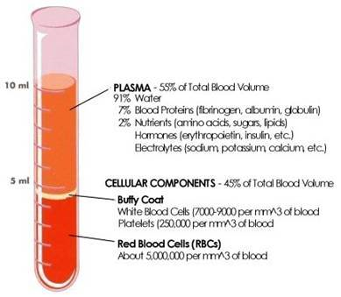
Whole Blood is a viscous substance (fluid) that contains a:
1. fluid portion (plasma)
2. cellular portion
*Depending on the species, plasma makes up 45% - 78% of the total blood volume.

Slide 5
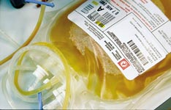
Plasma
91% water
7% proteins
2% other dissolved solutes
  Carbohydrates
  Vitamins
  Hormones*
  Enzymes
  Lipids
  Amino acids*
  Salts
  Gases
  Waste materials
  Antibodies*
  Other ions and molecules

Slide 6
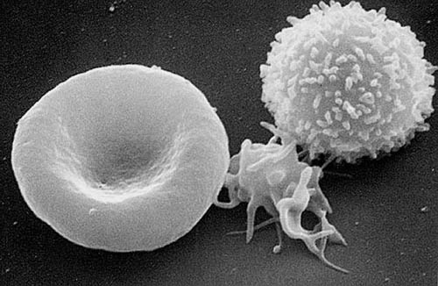
Cellular Portion of Blood
Erythrocytes
  Account for ~45% blood volume (dogs)
  and ~37% blood volume (cats)
Thrombocytes
  200,000 – 500,000 /µL = dog
  300,000 – 700,000 /µL = cat
Leukocytes
  6,000 – 17,000 /µL = dog
  5,500 – 19,500 /µL = cat

Slide 7

Hematopoiesis
General term for production of all blood cells.
Constant process; blood cells are not immortal.
Mostly occurs in the bone marrow.
Common ancestor of all blood cells is the pluripotent stem cell (PPSC) a.k.a. hematopoietic stem cell.
One PPSC will divide and eventually become many blood cells.

Slide 8
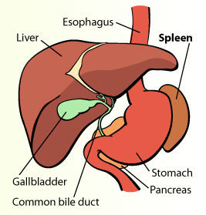
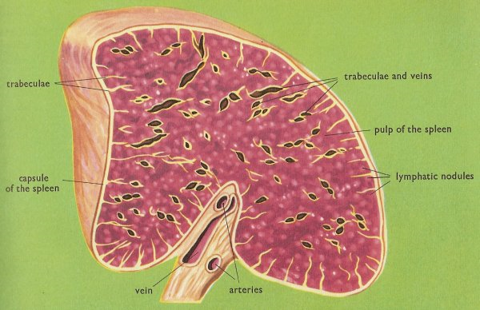
Blood Storage

Slide 9
Quiz
What are the three primary functions of blood?
What cells make up the cellular portion of blood?
What is contained in plasma?
What is the term used to describe production of all blood cells?
What is the common ancestor of all blood cells?
Where is blood produced?
Where is blood stored?

Slide 10

Now Let’s Focus on RBCs…

Slide 11
Red Blood Cells
Function:
  Carry oxygen from the lungs to the tissues
  Carry carbon dioxide away from tissues to the lungs and kidneys
  The RBC is a vehicle for hemoglobin which is the carrier molecule for oxygen.
  The bioconcave shape is a result of the cooperative binding from the 4 heme groups.

Slide 12
Hemoglobin
  Every heme group can carry a molecule of oxygen; 4 heme groups attach to each globin molecule. So each hemoglobin molecule can carry 4 molecules of oxygen.
Immature RBCs do not contain their full complement of hemoglobin yet
Rule of Thumb: Hemoglobin accounts for about 1/3 of the RBC (PCV)
Hemoglobin =
heme (iron) + globin (protein)
Iron is responsible for color of RBC

Slide 13
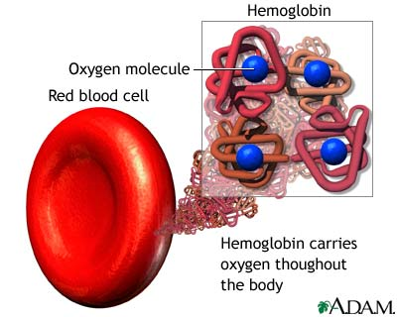

Slide 14
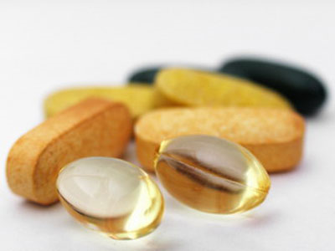
Recipe for Red Blood Cells
Water
Iron (for the synthesis of heme~)
  Copper (important in release of iron from tissues into plasma)
Protein/amino acids (~globin)
Essential Fatty Acids
Vitamin B6
Vitamin B12
Folic Acid (B9)

Slide 15
Erythropoiesis
Formation of erythrocytes.
Occurs in the bone marrow of normal adult animals.
  Occurs in the spleen and liver of the fetus.
Maturation time usually takes 5 days.
Average lifespan of RBC is about 110 days for dogs and about 68 days in the cat.
Erythropoiesis is a constant process.

Slide 16
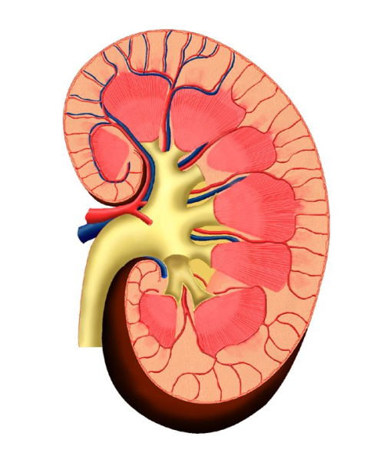

Erythropoiesis
1. Pluripotent stem cells (PPSC) exist in bone marrow
2. Erythropoietin (EPO) (a hormone) is released by kidneys in response to blood hypoxia
(kidney dysfunction can affect RBC production)
3. PPSC stimulated by EPO will begin to undergo mitiotic division and develop into myeloid stem cells.

Slide 17
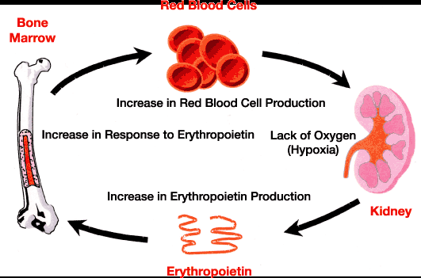
Erythropoiesis

Slide 18
Erythrocyte Maturation
Rubriblast– (14-19 µm) First morphologically identifiable RBC precursor
Prorubricyte - (12-17 µm)
Rubricyte - (12-15 µm)
Metarubricyte - (8-12 µm) - a.k.a. NRBC (nucleated red blood cell)
  - Released in cases of severe anemia
Reticulocyte - (7-10 µm)
  Not nucleated; contains nuclear remnants (Residual RNA)
  A.k.a. – polychromatophil (no NMB)
Mature RBC - (7-8 µm)

Slide 19
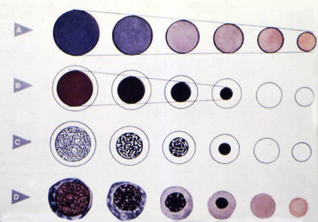

Slide 20
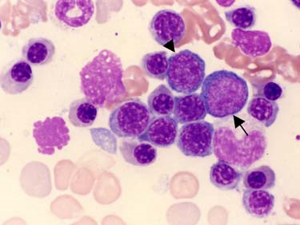
Canine Bone Marrow Aspirate
Bone marrow aspirate demonstrating erythropoiesis. Rubriblast (arrow), prorubricytes (arrowhead), and various stages of rubricytes (nucleated erythroid precursors) are present.

Slide 21
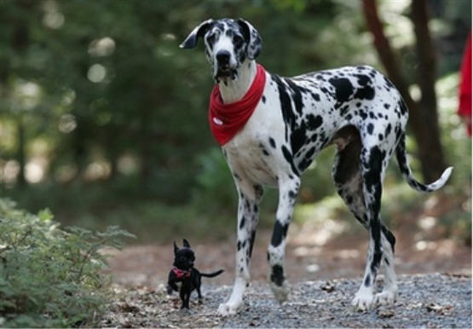
Lifespan and Destruction of RBCs
Lifespan of RBC = related to metabolism and weight of animal
Process of aging is called senescence.
As RBC becomes more senescent, enzyme activity decreases
  Glycolytic enzyme unable to break down glucose
  Cell becomes more round
  Volume decreases
  90% of destruction of senescent RBCs occurs by extravascular hemolysis.

Slide 22
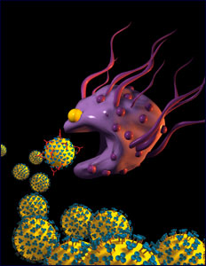
Normal Removal of Aged RBCs
  Surface membrane alterations (oxidative damage) or damaged cells are recognized by macrophages.
  Macrophages found all over the body (mostly of the spleen) phagocytize (engulf and “eat up”) old RBCs.
  Components of RBC breakdown are either removed by the body as waste or recycled.

Slide 23
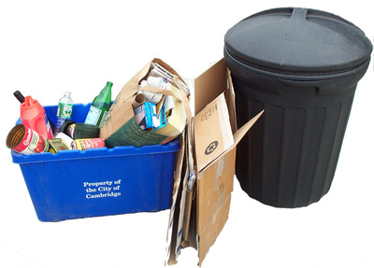
Extravascular Hemolysis
Hemoglobin is disassembled within minutes after phagocytosis begins
Iron is made available for re-use by the bone marrow
Amino acids return to the protein pool of the body
Carbon is released through lungs as carbon monoxide
Bilirubin is bound to albumin and transported to liver for conjugation.

Slide 24
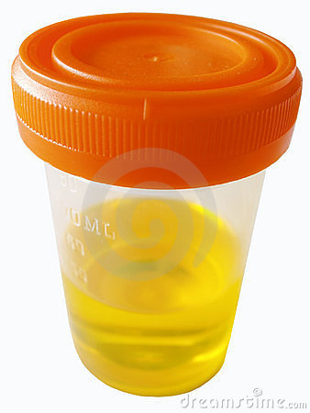
Bilirubin
In the liver, bilirubin is conjugated – joined to glucuronic acid -- and becomes water soluble.
Conjugated bilirubin is excreted as a bile pigment into the intestines.
In the intestines, it is converted into urobilinogen by bacteria.
Some urobilinogen is reabsorbed by kidneys and eliminated in the urine.
Some urobilinogen is converted to stercobilinogen and excreted in the stool.
These compounds are responsible for the color of urine and feces.

Slide 25
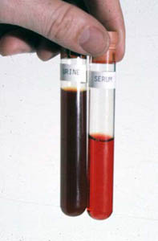
Intravascular Hemolysis
10% of normal RBC destruction takes place by intravasuclar hemolysis.
Haptoglobin picks up hemoblobin and carries it to the mononuclear phagocyte system in the liver for further breakdown.
Hemoglobinemia = When all haptoglobin is filled with hemoglobin, excess hemoglobin appears in the plasma
Hemoglobiniuria = Hemoglobin cannot get to the liver so it is carried to the kidney and eliminated in the urine.

Slide 26
Other Causes of Intravascular Hemolysis
Immune Mediated Hemolytic Anemia (IMHA)
RBC parasites (i.e. Babesia sp.)
Some bacteria (i.e. Clostridium, Leptospira)
Bee stings, snake envenomation
Some toxins (i.e. zinc toxicity in dogs)
Acute liver disease
Insulin therapy with some diabetic cats
Congenital defects
** Note that red cells can also lyse or rupture in vitro (either in the blood collection tube or during collection). When this occurs, the hemolysis is considered artifactual hemolysis.

Slide 27
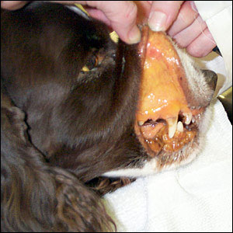
Jaundice/Icterus
Excessive RBC breakdown = hyperbilirubinemia (excess unconjugated bilirubin in plasma).
If there is too much bilirubin in the blood for the liver to be able to break down, it is deposited in the tissues.
Bilirubin in the tissues = jaundice; clinically seen as a yellowish color in the MM and sclera of the eyes
In liver disease, the liver is unable to break down a normal amount of bilirubin from normal RBC destruction and jaundice results.

Slide 28
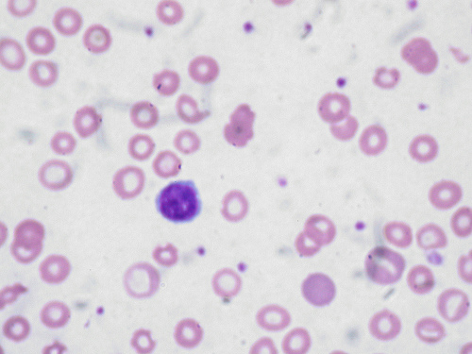
Anemia – Not enough RBCs
Pathological condition that results in decreased oxygen-carrying capacity of the blood.
Regenerative
  Caused by blood loss or hemolysis
Non-regenerative
  Caused by reduced or defective erythropoiesis
    Defective hemoglobin production

Slide 29
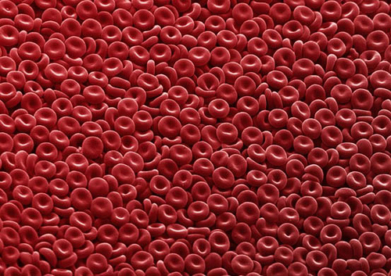
Polycythemia – More RBCs than needed
An increase above normal in the number of RBCs
Three types:
  Relative
    Hemoconcentration – loss of fluid from blood
  Compensatory
    Resulting from chronic hypoxia
    Ex: High altitudes, CHF
  Polycythemia rubra vera
    Rare bone marrow disorder characterized by increased production of RBCs for unknown reason.

Slide 30
Quiz
What is the recipe for RBCs?
What stimulates the production of RBCs?
As an RBC matures, what happens to its size? Color? Nucleus? What else?
What happens to an RBC as it becomes senescent?
Where does bilirubin come from? How is it eliminated from the body?
What causes jaundice/icterus?
What are some causes of intravascular hemolysis?
What are some causes of anemia?
What are the three different types of polycythemia?

Slide 31
Erythrocyte Morphology
Different species have different sized RBCs with varying degrees of central pallor.
Dogs have largest RBCs (~7 µm in diameter)
Cats, horses, cows, sheep, goats (3-4 µm)
Llamas and camels have elliptical (oval) RBCs
Deer have sickle-shaped RBCs
Birds, fish, amphibians, and reptiles have nucleated, elliptic RBCs.
Human RBCs are about the same size as those of dogs.

Slide 32
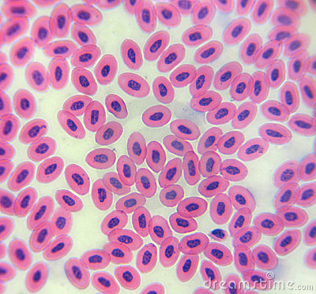
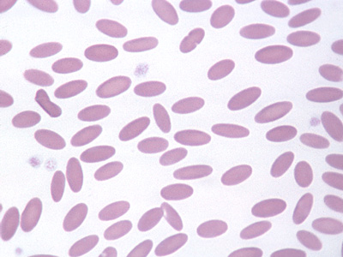
Chicken Llama

Slide 33
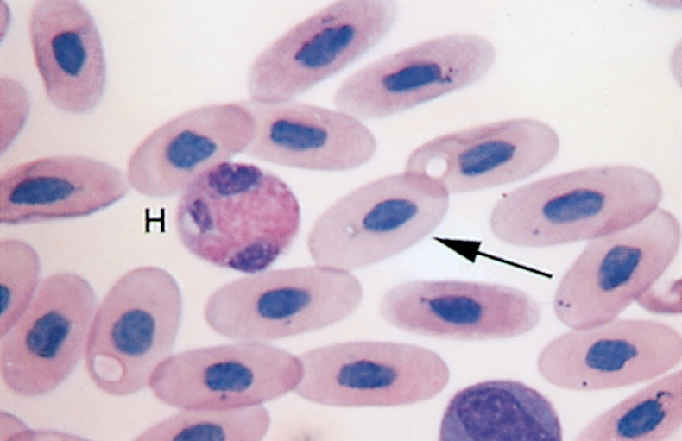
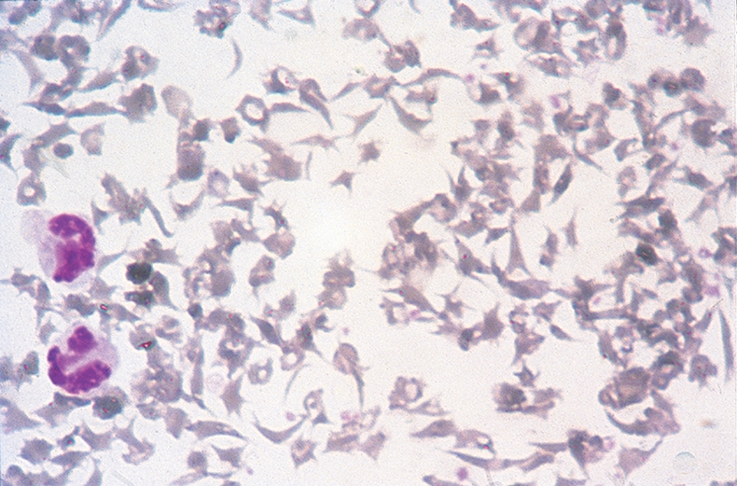
Reptile Deer

Slide 34
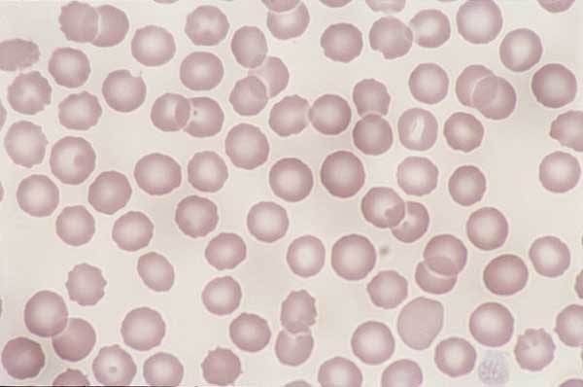
Normal RBC Morphology
Normocytes- cells look normal
Normochromasia - suggests adequate amount of hemoglobin and typical MCHC
Canine blood, normal erythrocyte morphology. Canine RBCs are all about the same size, shape, and color, and have a prominent area of central pallor

Slide 35
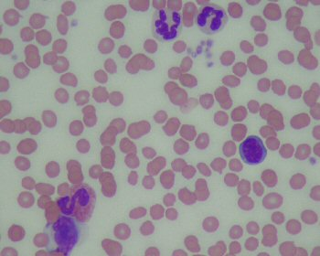
Normal RBC Morphology
Feline blood. Normal erythrocyte morphology. Feline RBCs are smaller than dog erythrocytes, exhibit a slight amount of crenation, and have a minimal area of central pallor

Slide 36
RBC Morphology
Morphologic characteristics of RBCs can be categorized according to:
  Cell arrangement on blood film
  Size
  Color
  Shape
  Presence of structures in or on the RBCs

Slide 37
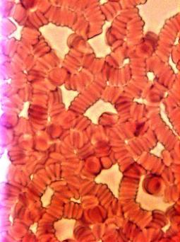
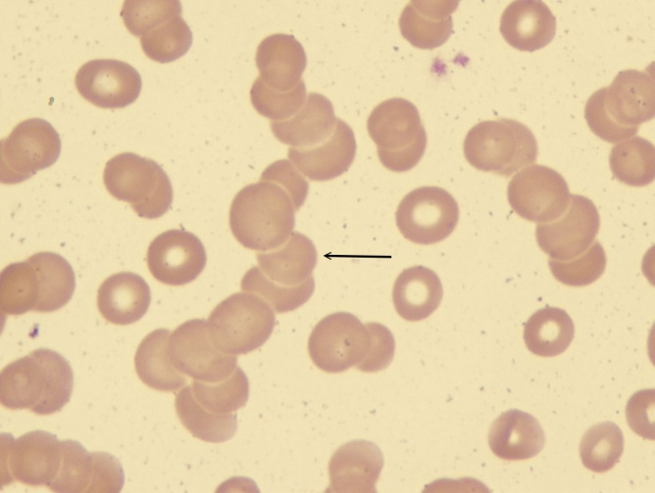
Rouleaux Formation
Grouping of RBCs in “stacks” that resemble coins
Marked rouleaux formation is seen in healthy horses.
Seen with increased fibrinogen or globulin concentrations
May be seen as an artifact in blood that has been held too long before preparing the blood film and in blood that has been refrigerated.

Slide 38
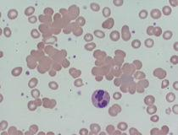
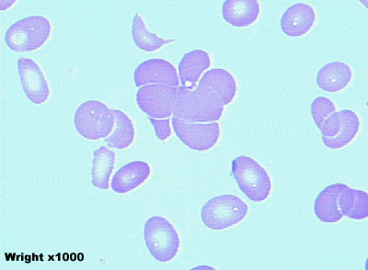
Agglutination
Occurs in immune-mediated disorders
Antibody coats the erythrocyte, resulting in bridging and clumping of RBCs
To differentiate between rouleaux and agglutination, add a drop of saline to a drop of blood and examine microscopically for agglutination.
  Rouleaux will disperse in saline.

Slide 39
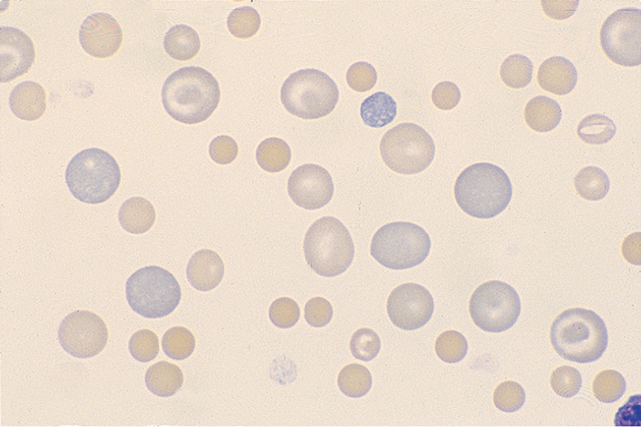
Anisocytosis
Variation in the size of RBCS
May indicate presence of macrocytes, microcytes, or both.
Common finding in normal bovine blood.

Slide 40
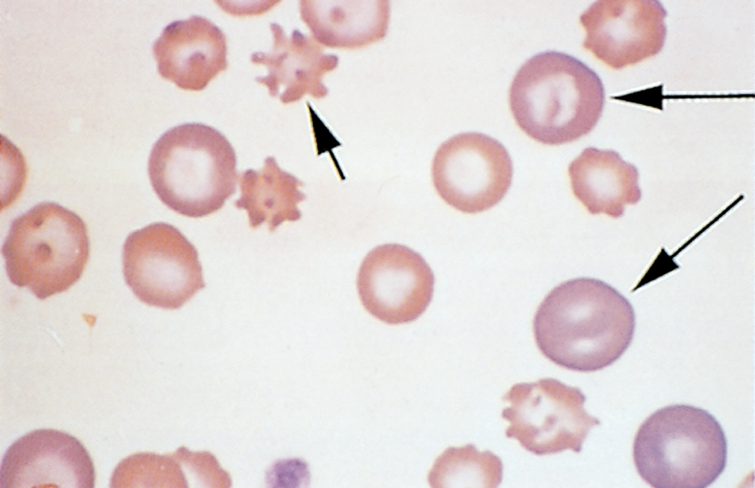
Macrocytosis
Erythrocytes are larger than normal with an increased MCV.
Usually immature, polychromatophilic RBCS (reticulocytes)
Seen in the presence of regenerative anemia.
Typically polychromasia is also present

Slide 41
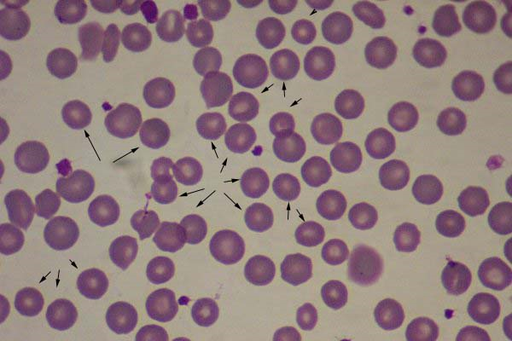
Microcytosis
Microcytes are RBCs with a diameter less than that of normal erythrocytes, with a decreased MCV.
Usually occurs with iron deficiency
Normal finding in shiba inu
and akita dogs

Slide 42
Polychromasia
Recall that the younger the cell in the RBC maturation series, the more dark blue the staining due to increased metabolic activity.
Mature RBCs stain red because they have their full complement of hemoglobin.
Hb production begins right before cell loses nucleus; immature RBCs with some Hb present stain purple/lavender because there is still some metabolic activity going on within the cell.

Slide 43
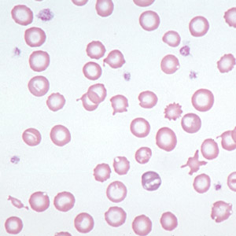
Hypochromasia
RBCs that have decreased staining intensity caused by insufficient hemoglobin within the cell.
Cell will normally appear more darkly stained along the periphery, gradually tapering to a much paler central region.
Frequently observed in iron deficiency anemia caused by chronic blood loss or parasitism.
Animals with hypochromasia almost always have microcytosis as determined by a decreased MCV.

Slide 44
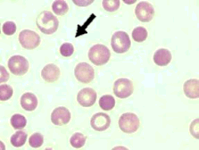
Hyperchromasia
Refers to cells that appear more darkly stained than normal RBCs.
Gives appearance of oversaturation with Hb and suggests an increase in MCHC.
Because RBC has a fixed maximum capacity for Hb, oversaturation cannot occur.
Presence of hemolysis, Heinz bodies, and lipemia can interfere with tests and artifactually increase MCHC
Spherocytes (arrow below) have the illusion of being hyperchromic and microcytic but still have a normal cell volume

Slide 45
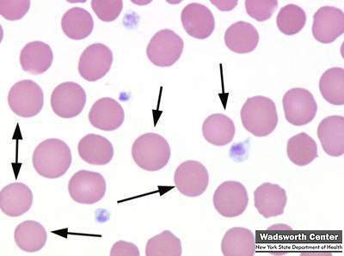
Spherocytes
Dark red staining, appear smaller than average sized RBC, round, lacks central pallor
Not usually detected in species other than dogs.
Common in immune-mediated hemolytic anemia (IMHA)
Antibodies recognize “self” as foreign and attach themselves to surface of RBCs
May also be seen after transfusion with mismatched blood

Slide 46
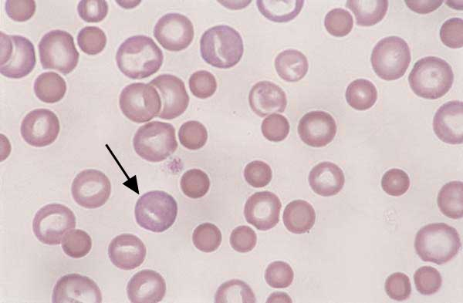
Canine blood. Regenerative anemia with spherocytes. Anisocytosis is due to macrocytic cells and spherocytes, which are smaller than normal and lack central pallor. Spherocytes are associated with hemolytic anemias due to immune disease or fragmentation. The polychromatophilic RBC with a rod- shaped area of central pallor (arrow) is a stomatocyte

Slide 47
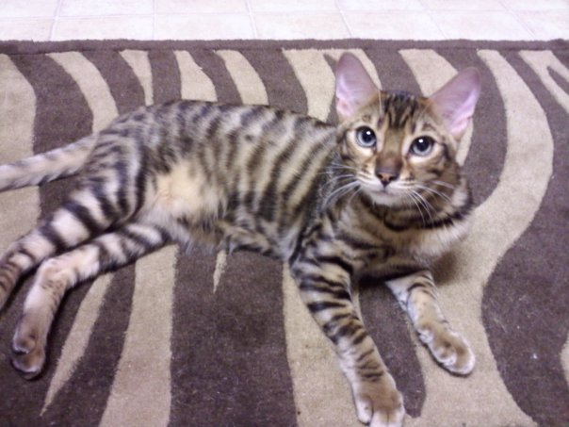
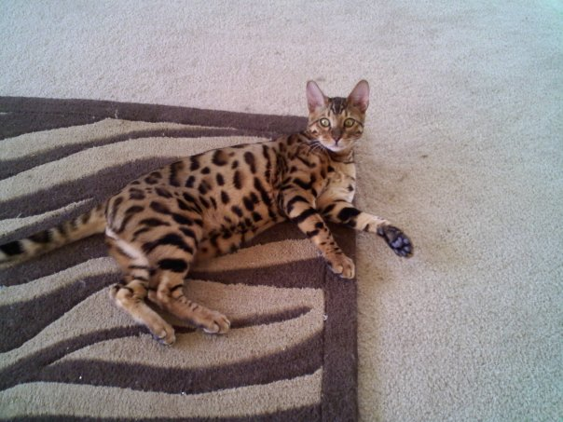
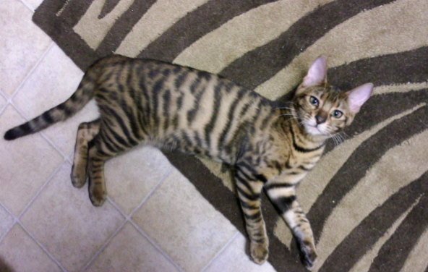
Raao, Beau & Meeah

Slide 48
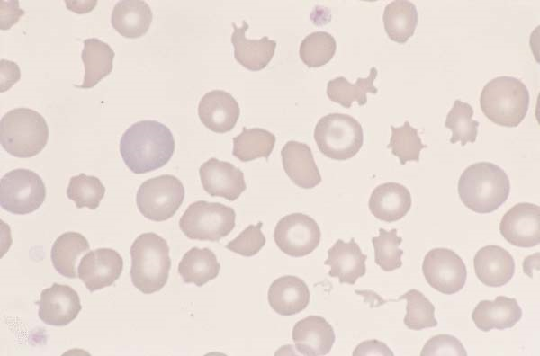
Poikilocytosis
Variations in the shapes of RBCs
(poikil ~ irregular)
A general term to encompass nondescript variations in shapes of erythrocytes that are scattered throughout the blood film.
Term does not suggest a specific diagnosis.
Note: poikilocytosis, anisocytosis, and polychromasia are present on this slide

Slide 49
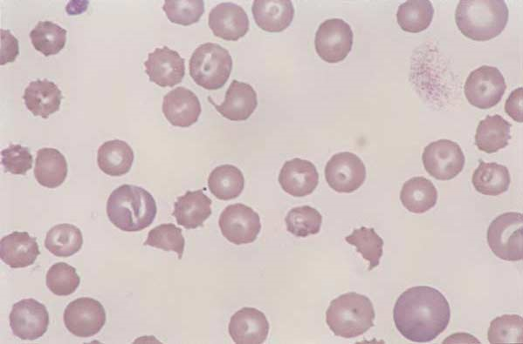
Schistocytes
RBC fragments resulting from shearing of red blood cell by intravascular trauma.
May be seen with Disseminated Intravascular Coagulopathy (DIC) or with iron deficiency
Expect to also see thrombocytopenia on blood film of animals with DIC
Canine blood. Schistocytes. Fragmentation of RBCs results in the formation of schistocytes. These cells are formed when RBCs are sheared by convoluted vascular channels, intravascular fibrin deposition, or excessive turbulence. The RBCs have sharp cuts in the cell margin that produce membrane tags and cells that have a helmet shape

Slide 50
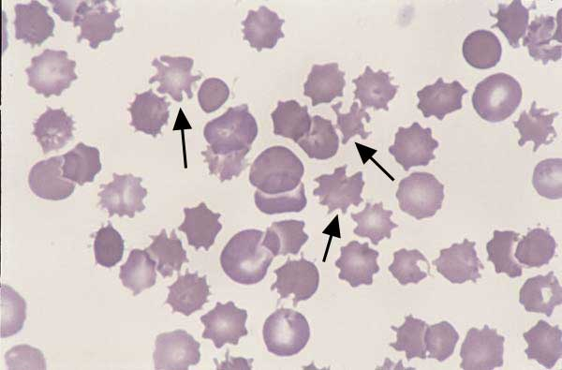
Acanthocytes (“Spur Cells”) have irregular membrane projections of variable length and diameter with rounded tips. Unevenly sized and spaced
May be seen in blood smear of Cats with hepatic lipidosis, Dogs with liver disease or hemangiosarcoma of the liver
Represent in vivo alteration rather than artifact.
Canine blood. acanthocytes (arrows). A few spherocytes are also noted.

Slide 51
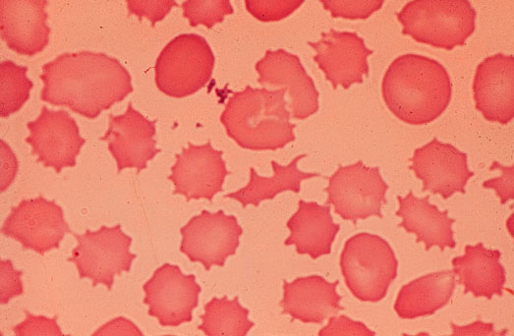
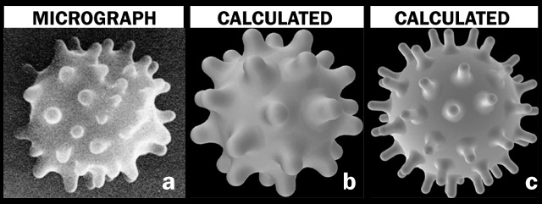
Echinocytes “Burr Cells”
Result from ruptured cell membranes
In-vivo change
Appear elongated, ruffled, with relatively evenly sized and spaced, short, blunt projections
Associated with renal disease, lymphosarcoma or rattlesnake invenomation in dogs

Slide 52
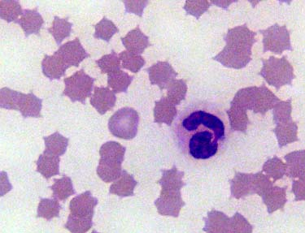
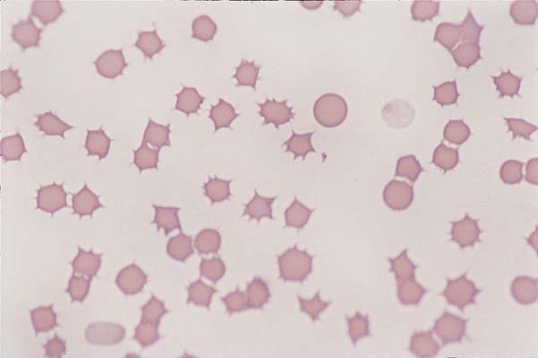
Echinocytes“Crenation”
Result from ruptured cell membranes
*Note: know difference between in-vivo (within the body) and in-vitro (within glass)
In-vitro Change
  Artifactual
  Slow drying of blood film
  Underfilling of EDTA tube
Relatively round, ruffled RBC with sharp, evenly spaced spicules (commonly seen around edge of cell) represent an artifact in RBC morphology called crenation. *Usually affects all RBCs on entire film or in given area on the film.

Slide 53
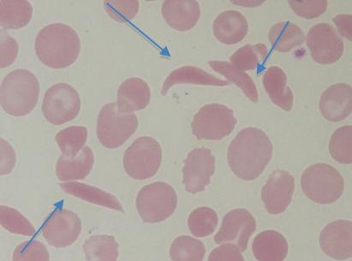
Drepanocytes “Sickle Cells”
Crescent shaped with pointed ends
Result of alteration in hemoglobin due to low oxygen tension
Normal finding in deer, Angora goat, and some sheep

Slide 54
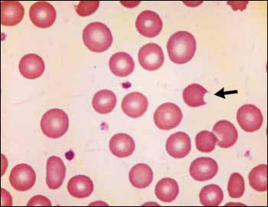
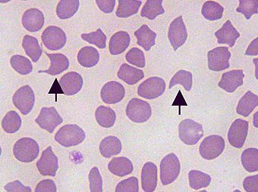
Keratocytes “Helmet cell”
Also called “Blister cells” or “Bite cells”
Presence of keratocytes has been associated with hemangiosarcoma, neoplasia, glomerulonephritis, and various hepatic diseases.

Slide 55
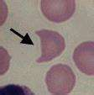
Keratocytes (continued)
Keratocytes are believed to result from intravascular trauma
  Fibrin strands bisect (cut) the RBC
  Opposing sides of cell re-adhere to one another to form a pseudovacuole that resembles a “blister-like” projection
  Once “blister” ruptures, remaining cell resembles a helmet or two upright cattle “horn-like” projections
Can also result from oxidative injury found with iron deficiency
  Blister on side of RBC formed by thin cell membrane, forming an area devoid of hemoglobin

Slide 56

Codocytes “Leptocytes”
Group of RBCs characterized by increased surface area of cell membrane.
  Target cells: Target with a bullseye
    Have central area of hemoglobin surrounded by area of pallor
    Periphery of cell contains band of hemoglobin
    A few may be seen in normal smears
    May be associated with iron deficiency, IMHA, liver diseases, and some inherited disorders.

Slide 57


Codocytes (continued)
Folded cells and stomatocytes have a transverse, raised fold extending across the center of the cell and a clear, slit-like pale region in the center.
Barr cells or “knizocytes” have a bar of hemoglobin across the center of the cell.
Canine blood/ post-splenectomy: Arrows = acanthocytes; asterik = knizocyte; Howell-Jolly body also present
Folded cells and stomatocytes

Slide 58


Folded cells and stomatocytes are considered an artifact if the areas of pallor are perpendicular to the feathered edge.
Stomatocytes have a “smiley faced” appearance to the area of central pallor. (Stomat/o = mouth)

Slide 59

Anulocytes
Bowl shaped RBCs that form as a result of a loss of the membrane flexibility.
Cell cannot return to normal shape after passing through a narrow capillary.
May be seen in any acute disease.
Can also occur due to low hemoglobin concentration or as an artifact.

Slide 60

Dacryocyte “Teardrop cells”
Teardrop shaped RBCs with a single elongated or pointed end
May be seen in myeloproliferative diseases or kidney and splenic disorders of dogs.
Can be an artifact. Check to see if the “tails” are all pointing in the same direction.

Slide 61


Howell-Jolly Bodies
Basophillic nuclear remnants observed in young RBCs during their response to regenerative anemias
Normally, as cells containing nuclear remnants pass through the spleen, phagocytic cells remove the remnants.
Therefore, HJBs may be seen with splenic disease or in an animal with the spleen removed.

Slide 62


Basophilic Stippling
Observed in RBCs that contain abnormal, residual RNA.
Small, dark blue bodies within the RBC.
Common in immature RBCs in cats
Characteristic finding with lead poisoning in dogs.

Slide 63


Heinz Bodies
Particles of denatured hemoglobin resulting from oxidative injury attach to RBC membrane.
They stain blue with NMB and appear as a pale area with quick stain.
Seen in acetaminophen and onion ingestion in cats and dogs
HBs are often increased in concentration with diseases such as lymphosarcoma, hyperthyroidism, and diabetes mellitus in cats
Normal cat blood may have up to 5%

Slide 64



